Slide 1
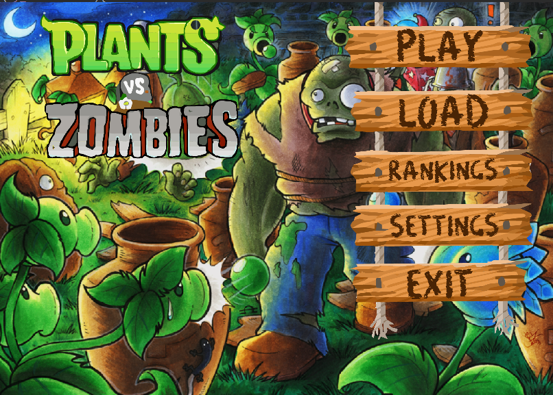
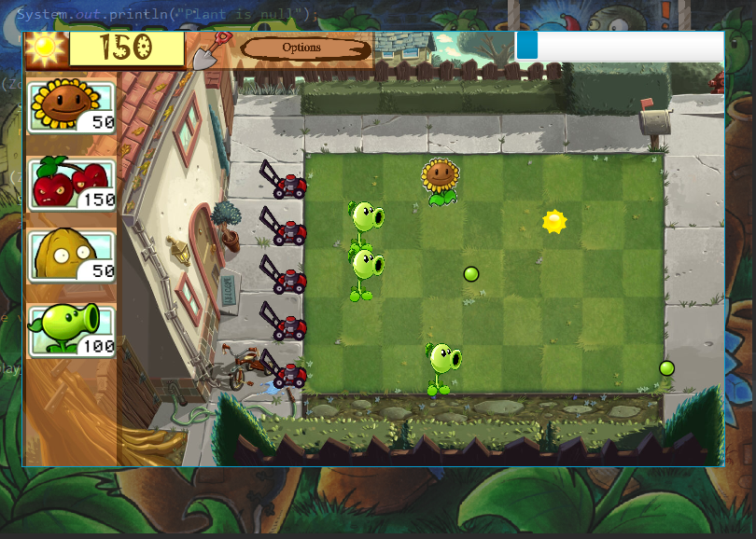
AP Project – Plants v Zombies
Aditya Rastogi
Shrikant garg

Slide 2
Design & Implementation
The Game has custom Buttons which are made using special .css files.
Each Stage / Scene is Undecorated or Transparent to provide it a more finished feel.
All animations are handled by the Timeline Attribute provided in the JavaFX framework.
The Main Menu Functionality provides a Settings Menu, A Hall of Fame, Load Game Functionality etc.
The Code Makes Use of MANY OOP CONCEPTS such as Encapsulation in the form of Inner Classes and Access Specifiers.
Many Design Patterns Such as Singleton, Factory etc. have been implemented in the code.
Many JavaFX Elements have been made static so that their reference is available throughout the package.
Collisions in the GUI have been done by specifying Event Listeners to all Plants and Zombies.

Slide 3
Work Division
We both have worked together in the Project by contributing to it in every manner possible.
For the First Deadline we both worked on the UML Diagrams contributing to it equally.
For the Second Deadline Shrikant took care of the Design Part of the Game, designing Buttons, different loading screens, creating assets etc. while Aditya and Shrikant took care of the Coding Part of the Deadline.
For the Third Deadline both of us took care of the code, side by linking various areas of the front to the back end.

Slide 4
Bonus
We have implemented a story in our game, the weather changes during our game and different kind of tokens fall down giving different powers.
There is a special plant that we unlock in our last level, namely the Brain Flower which attracts all the zombies in the lane it is placed, providing you the opportunity to strategize by placing all the attacking or barrier plants there.
We have also implemented 5 types of zombies, including the almighty, invincible Boss Zombie.

